Slide 1
BUSINESS FORECASTING – CIA 4
Submitted by
Shara George Vaidian

Slide 2
Introduction
In the world of finance, understanding the dynamics between different market indices and external economic factors is crucial for making informed investment decisions. The S&P 500 Index (SPX) is a widely recognized benchmark for the U.S. stock market, representing the performance of 500 large companies. On the other hand, the INViXN Index is a measure of Indian market volatility, often referred to as the "fear index," as it reflects investor sentiment and market uncertainty.
The exchange rate between the U.S. Dollar (USD) and the Indian Rupee (INR) is an important economic indicator that can influence global financial markets. Fluctuations in this exchange rate can impact international trade, investment flows, and economic stability.

Slide 3
OBJECTIVE
This analysis aims to forecast the difference between the SPX Index and the INViXN Index, using the USD to INR exchange rate as an exogenous variable. By understanding how these indices interact with the exchange rate, we can gain insights into market behavior and potential investment opportunities.

Slide 4
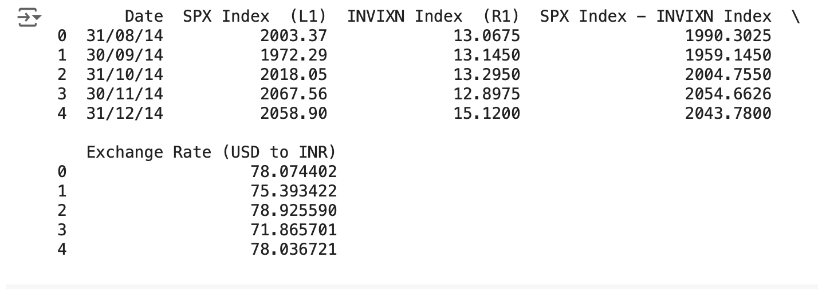
Data Overview
Source: BLOOMBERG
Key variables: SPX Index - INViXN Index, EXCHANGE RATE (USD TO INR)
Time period: 2014 -2024(AUG)
Monthly aggregation of data

Slide 5
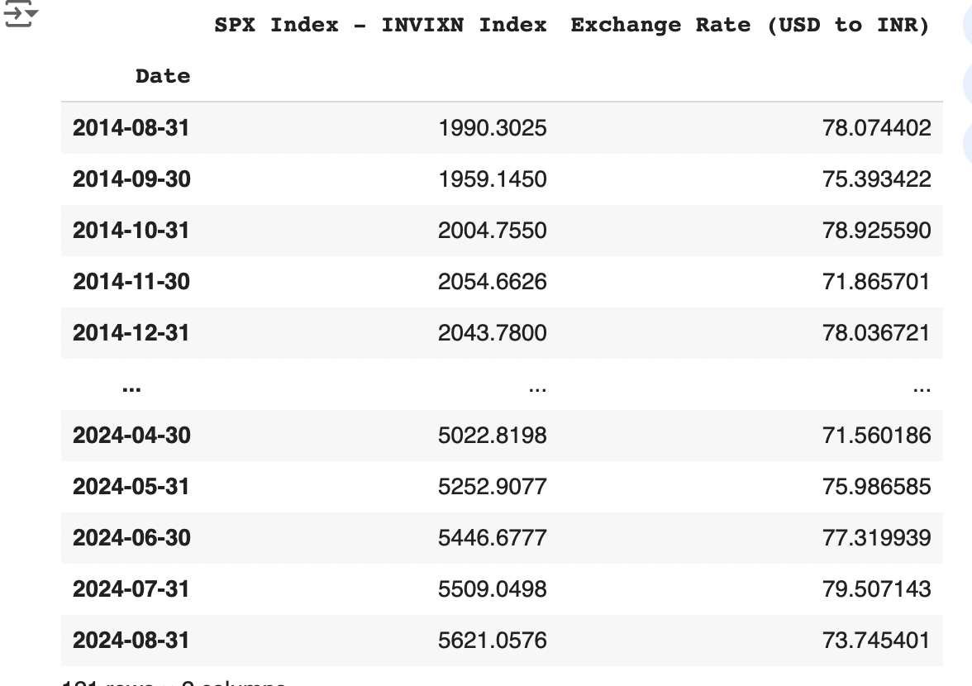
Data Preprocessing
Converted 'Date' to Date type
Checked and handled missing values
Removed irrelevant columns
Aggregated data by month and year

Slide 6
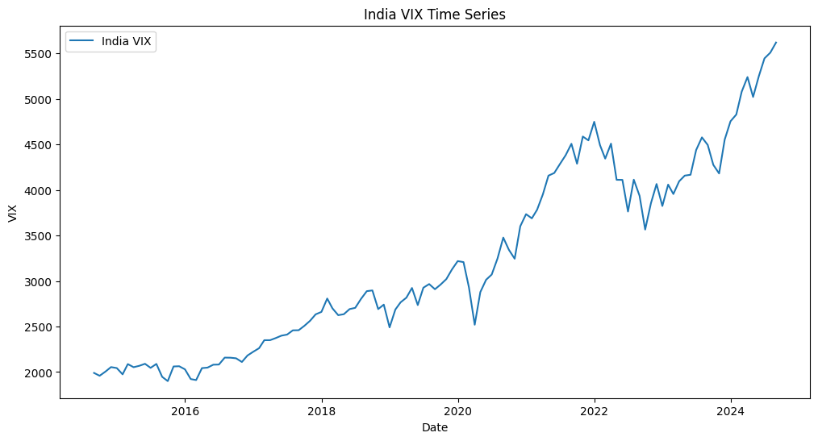
Time series Visualaizations
The India VIX time series plot reveals a general upward trend in market volatility over the period 2016-2024. However,there are also significant fluctuations, indicating periods of both low and high volatility. The recent years have seen particularly elevated levels of volatility, potentially influenced by economic uncertainty, geopolitical events, monetary policy changes, and global market conditions. Further analysis, such as correlation analysis and event analysis, could provide deeper insights into the factors driving these volatility patterns.

Slide 7
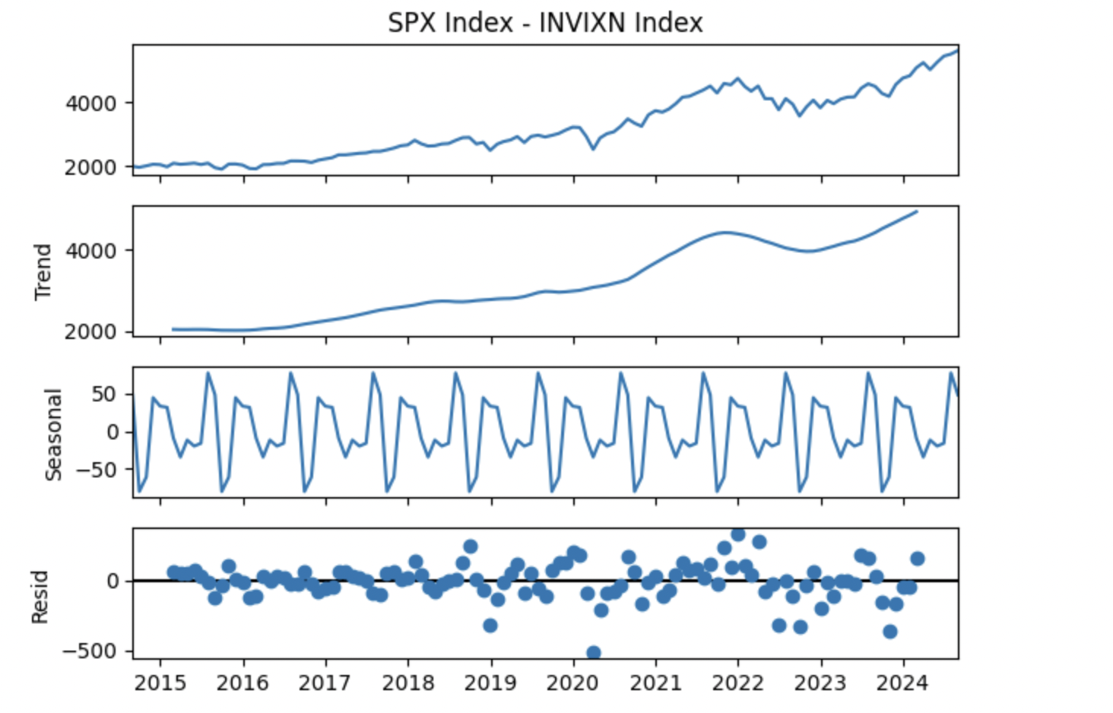
Time Series Decomposition
The decomposition of the SPX Index - INVIXN Index time series shows a clear upward trend, particularly after 2019, and a strong seasonal pattern with regular annual fluctuations. The residuals, which capture the remaining variability, are centered around zero, indicating that most of the data's variance is explained by the trend and seasonality components. Overall, the series exhibits a strong trend and consistent seasonality, with minimal residual noise.

Slide 8
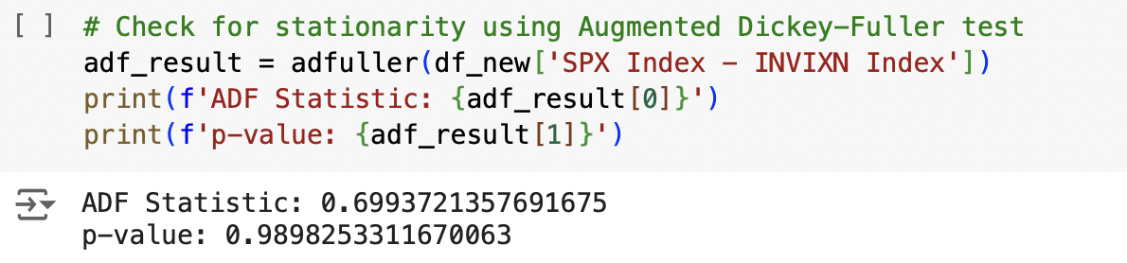
STATIONARITY CHECK
To make the data stationary the following were done:
Differencing
Log
Box Cox Lambda
Even after this the data was not stationary.

Slide 9
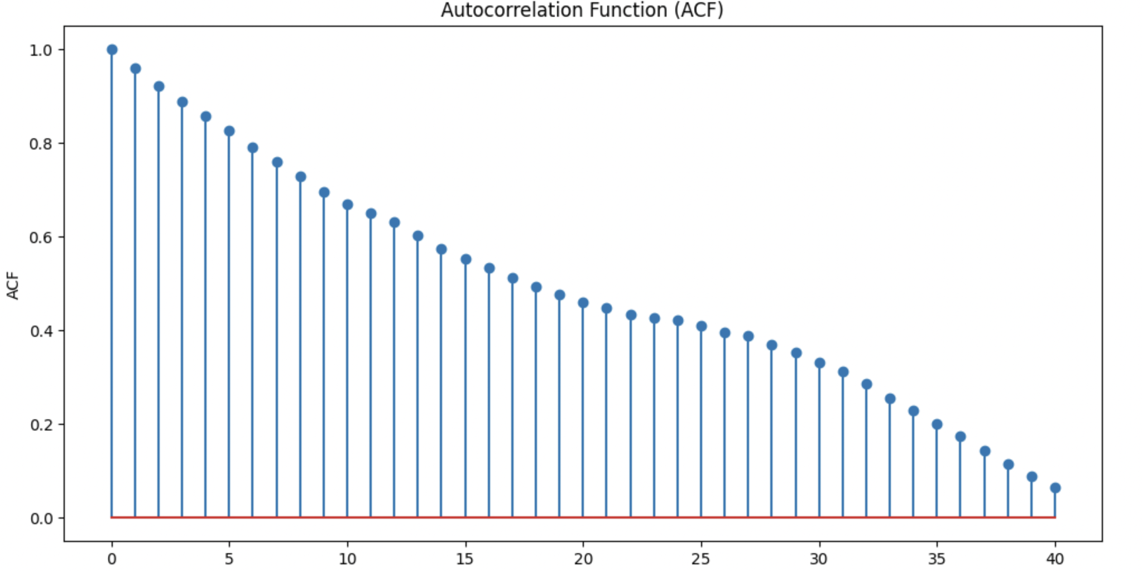
ACF AND PACF
The Autocorrelation Function (ACF) plot shows a gradual decrease in the autocorrelation values as the lag increases, indicating a strong positive correlation between current and past values in the time series. The slow decay suggests that the series is not white noise and exhibits persistence or trend. This pattern is common in non-stationary time series, where past values significantly influence future values, making the series predictable based on its history.

Slide 10
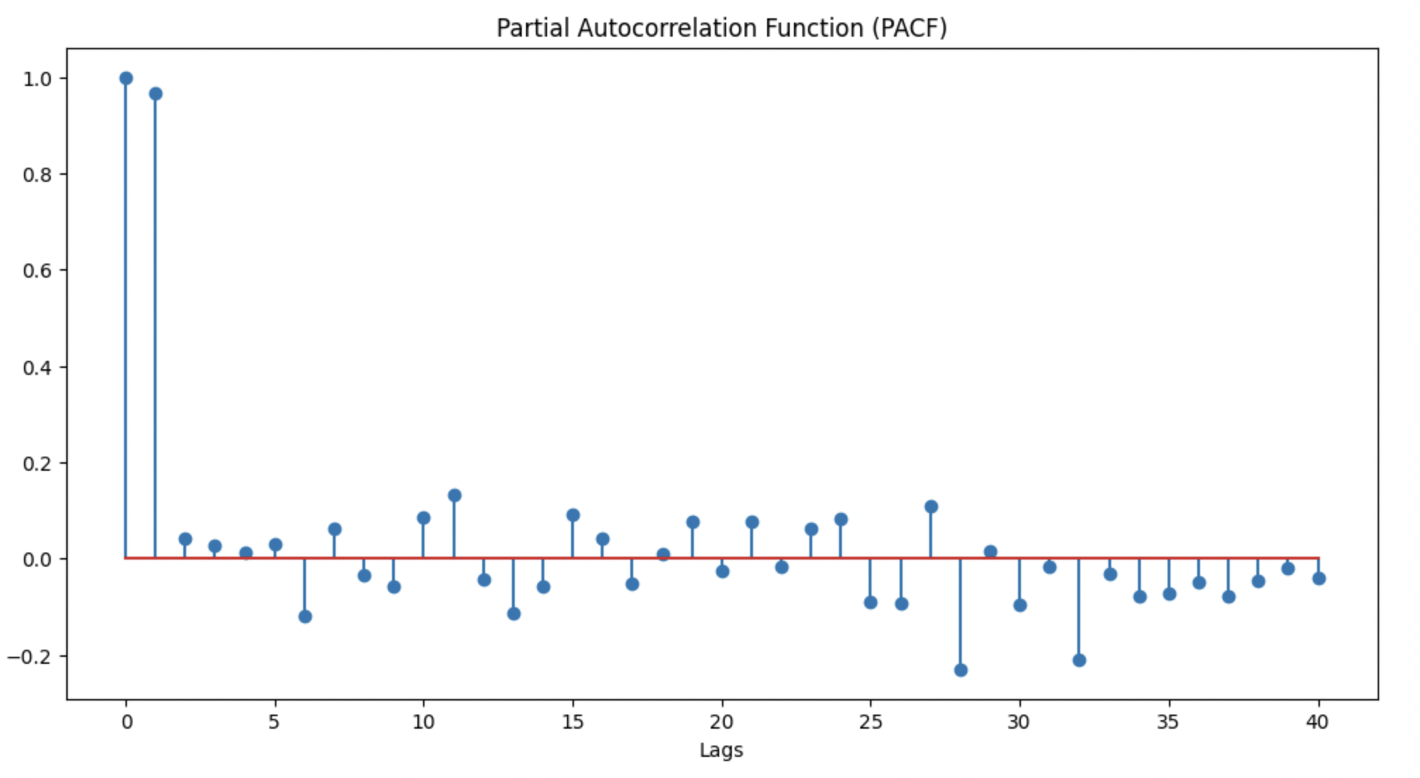
ACF AND PACF
The Partial Autocorrelation Function (PACF) plot shows significant correlation at lag 1, followed by a sharp drop to near-zero correlations at subsequent lags. This indicates that the series has a strong first-order autoregressive (AR) component, meaning that the current value of the series is primarily influenced by the immediately preceding value. The PACF suggests that the underlying time series might be well-modeled using an AR(1) process.

Slide 11
FOREACASTING
MODELS USED:
RNN
CNN
LSTM
ARIMAX
ARCH
GARCH
ETS

Slide 12
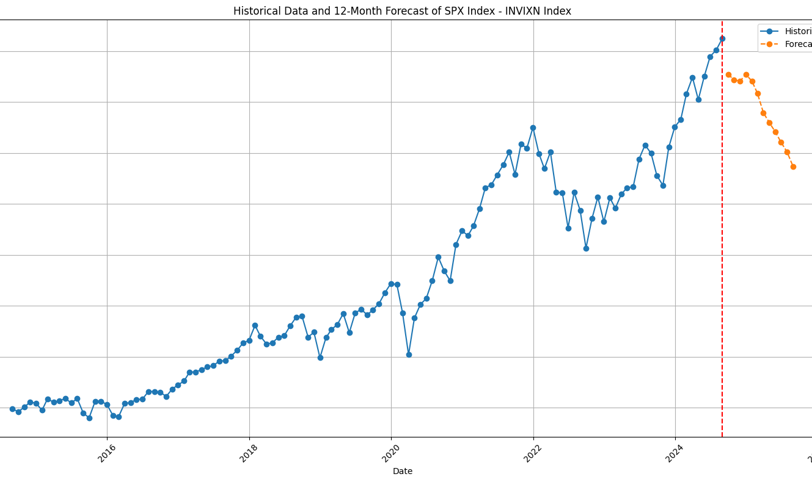
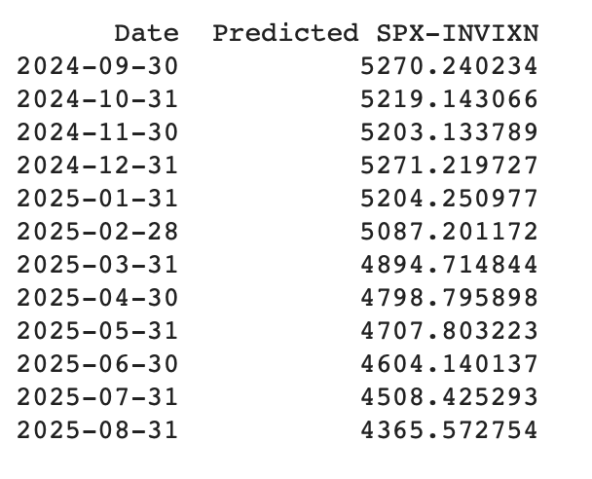
RNN

Slide 13

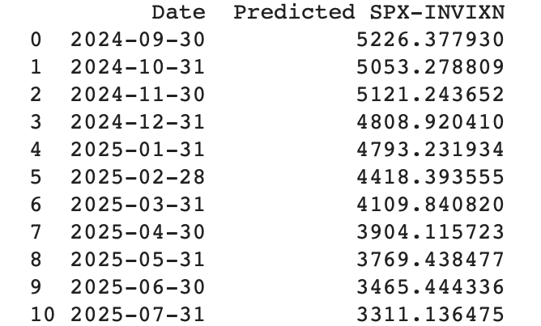
CNN

Slide 14
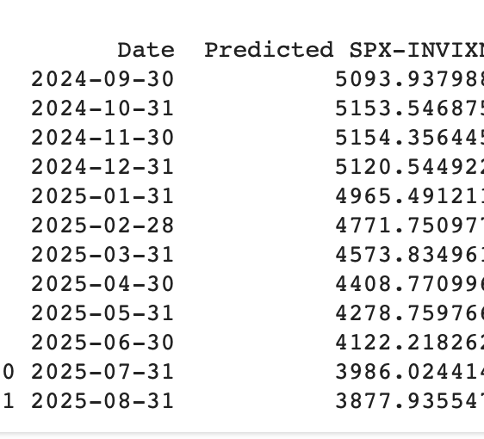

LSTM

Slide 15
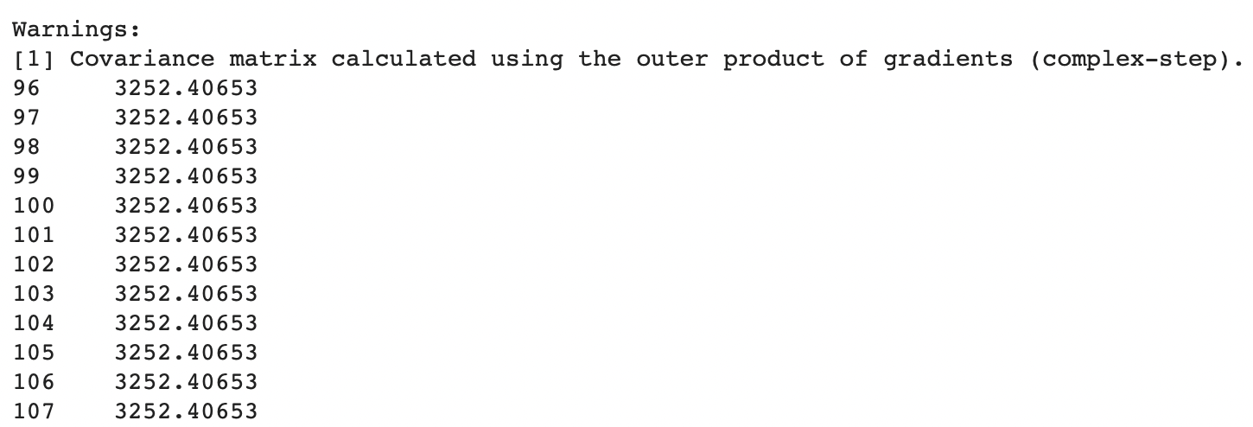
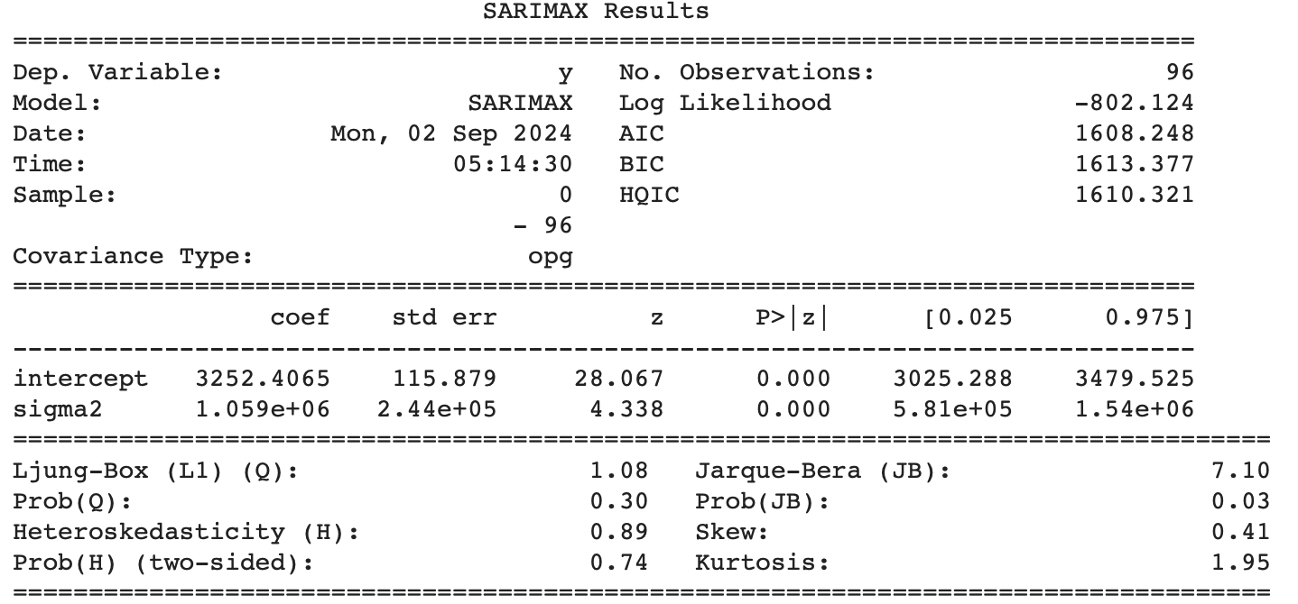
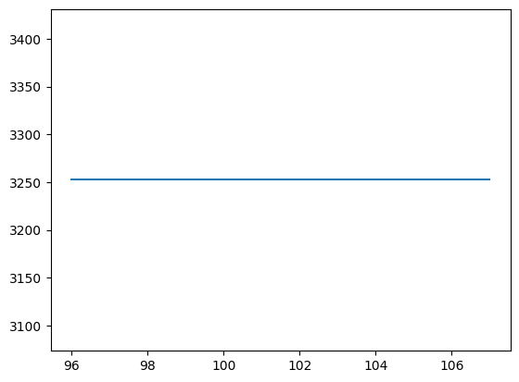
ARIMAX (0,0,0)

Slide 16
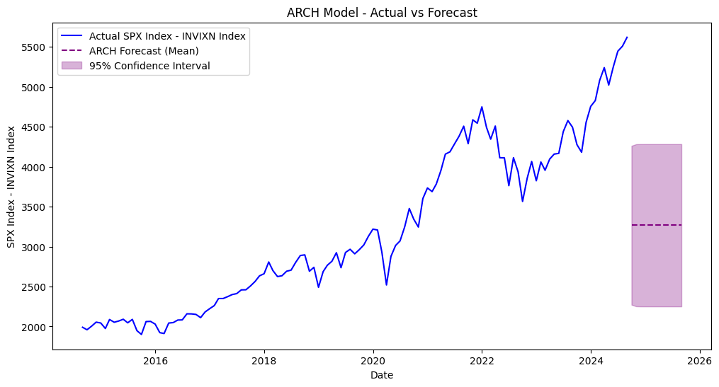
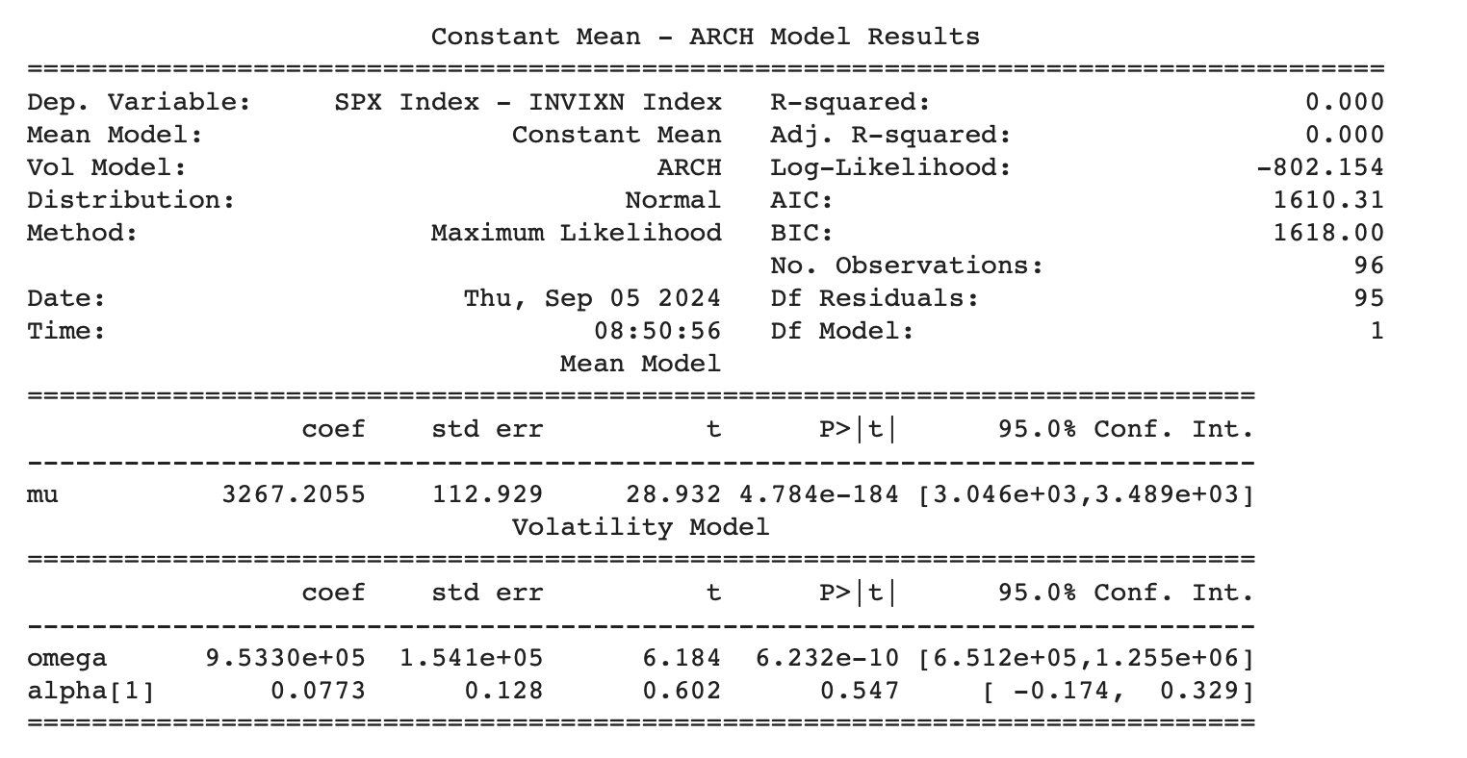
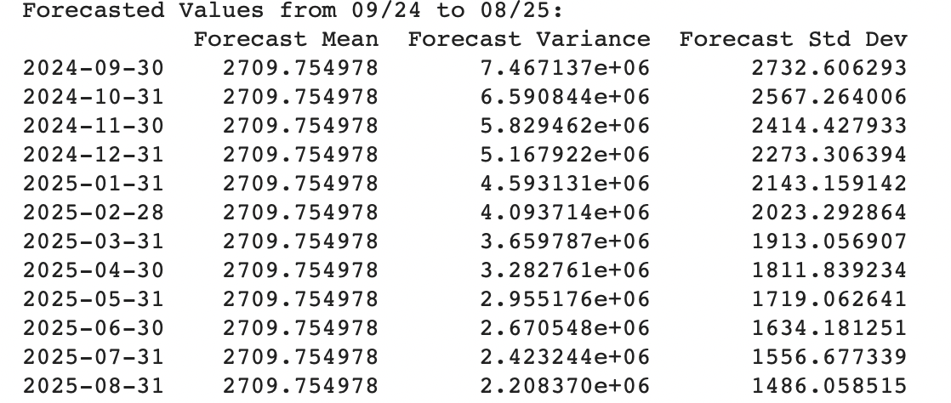
ARCH MODEL

Slide 17
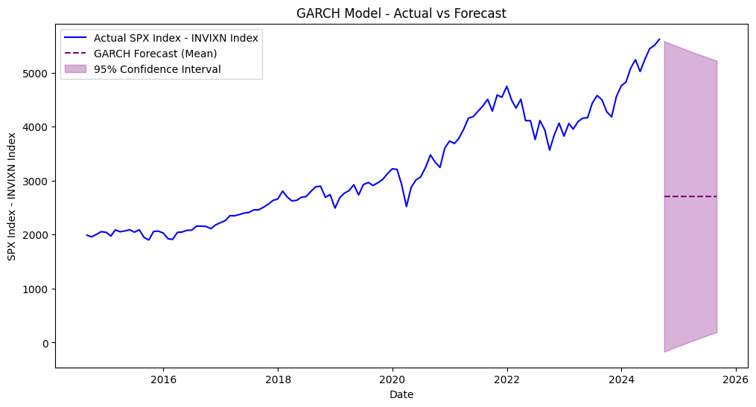
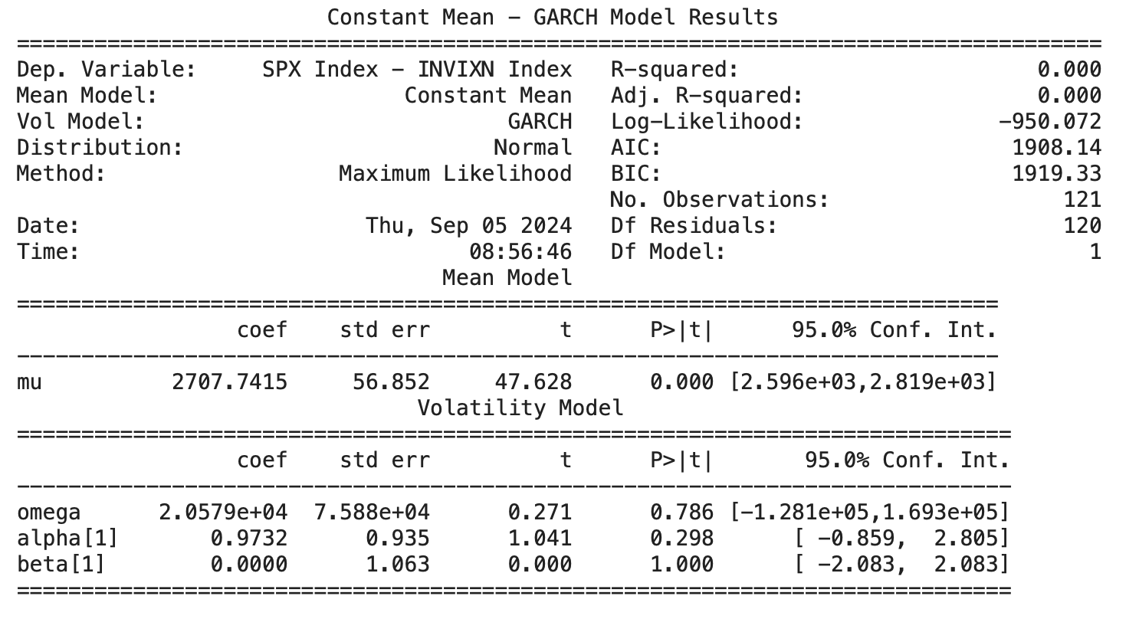
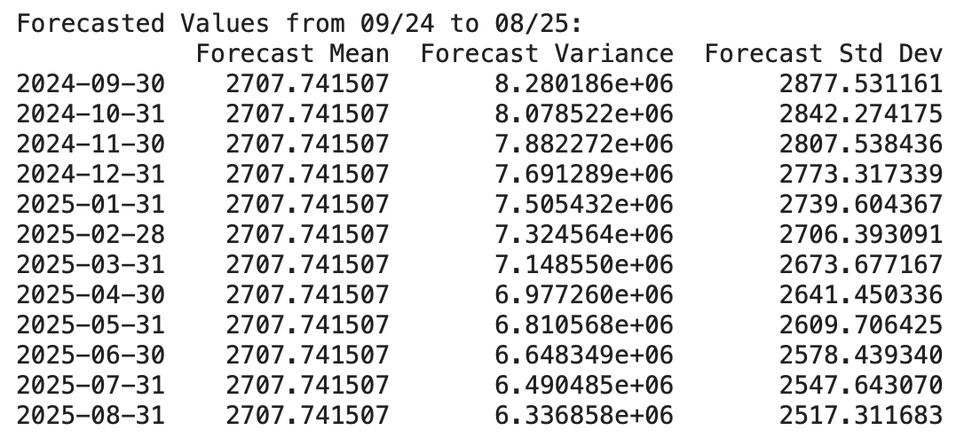
GARCH MODEL

Slide 18
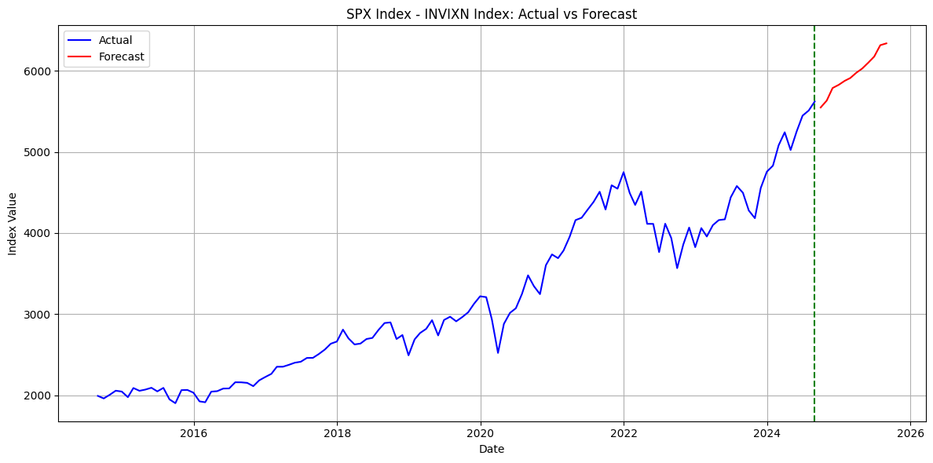
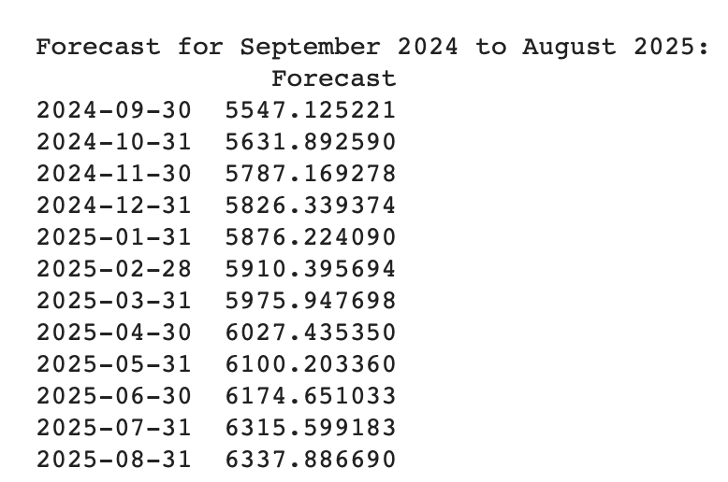
ETS MODEL

Slide 19
LEADERBOARD
MODEL | AIC | BIC | RMSE | MSE | MAE
RNN | 5288 | 8235 | 0.083619 | 0.006992 | 0.069909
CNN | 71148 | 110012 | 0.119286 | 0.014229 | 0.112025
LSTM | 61610 | 95270 | 0.124854 | 0.015588 | 0.103650
ARIMAX | 1608 | 1613 | 959 | 920880 | 816
ARCH | 1610 | 1618 | 2664 | 7099019.6894 | 2500
GARCH | 1908 | 1919 | 2317 | 7331864 | 2273
ETS | 1237 | 1282 | 3431 | 11777466 | 3301

Slide 20
The ETS (Exponential Smoothing) model performs best in AIC (1237) and BIC (1282), favoring simpler models. However, the RNN (Recurrent Neural Network) model outperforms in error minimization with the lowest RMSE (0.083619), MSE (0.006992), and MAE (0.069909). Despite the ETS model’s advantages in simplicity, the RNN's lower error rates indicate better predictive accuracy. Unless model simplicity is a priority, the RNN is recommended for its superior predictive performance.

Slide 21
THANK YOU

